Slide 1
Peppermint
Sales dashboard
February
2019

Slide 2
What is Peppermint?
Team Members
Concept
Motivation
Alton Salmon
Kevin Luu
Vicki Hope
A sales data visualization tool that:
Displays company sales data
Simplifies visualization of complex data
Provides “at-a-glance” performance status
Build on skills learned in previous project
Continue topic related to financial sector
Simulate real-world application
Bicycle business (Handlebars Express)
Meet project requirements
Learn new JavaScript libraries and gain additional experience with React.js

Slide 3
Problem(s) to Solve
Reduce Initial Cost for Sales Dashboard
Improve Ability to Customize Application
Represent complex sales data in a visual, relevant way
Notes:
There are many expensive dashboard products in the market today, and many that may have visual appeal but are overly complicated making them difficult to interpret.
Enter Peppermint…
the affordable, fully customizable Sales Dashboard that is easy to interpret.
Some studies show that with improved comprehension of sales data statistics, comes longer retention of that information.

Slide 4
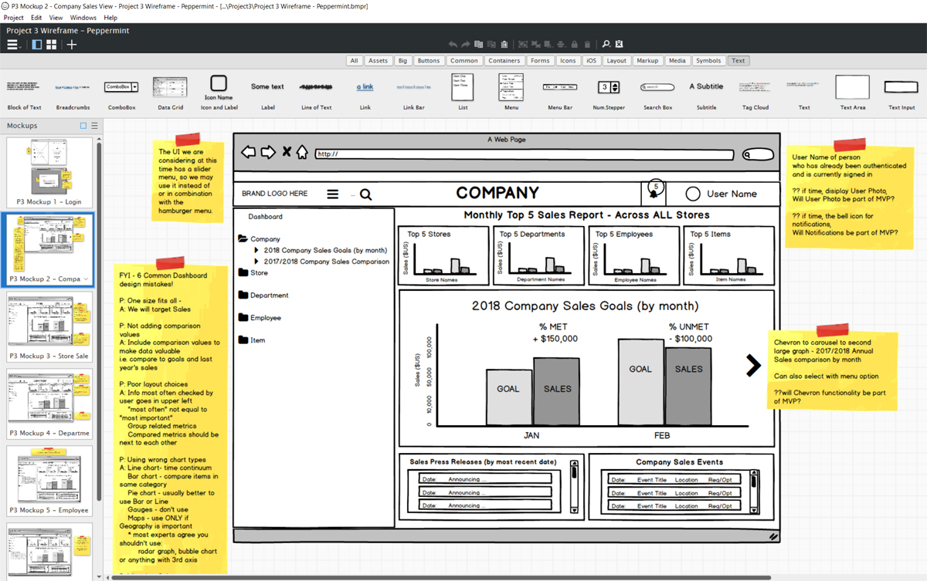
Design Process - wireframe
Brainstorm, select idea
Create wireframe
Balsamiq Mockup
Decide MVP requirements
Design for desktop/tablet
Functional log in
Dashboard Company View
https://balsamiq.com/wireframes/
Notes:
.

Slide 5
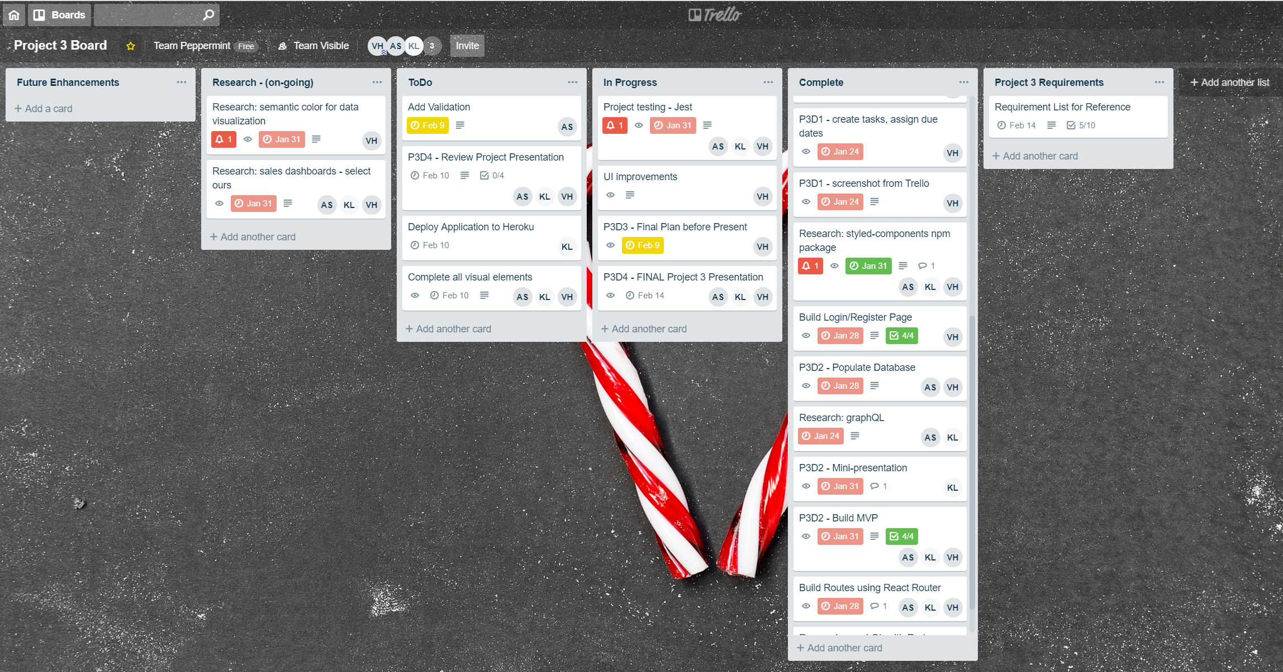
Design Process – project management tool
Select project tool
Trello
Create/assign tasks
Set tentative due dates
Maintain status
Meet frequently
https://trello.com

Slide 6
Design Process - assignments
Alton
Setup webpack/babel
Database models
GraphQL
Passport-jwt authentication
Express API routes
MongoDB
Database interface
Redux
Kevin
GitHub code master
Implement ApexCharts
Dashboard – Material-UI
Database interface
mLab setup
Redux
Vicki
Project organizer
Trello
Balsamiq
Presentation/video
Login Screen – Material-UI
Axios (API login route)
Seed data for database

Slide 7
Technology Requirements
JavaScript
MERN Stack
MongoDB
Express
React
Node
Model/View/Controller
ApexCharts.js
Axios
Bcrypt
CORS
GraphQL
Material-UI
Moment
Passport-jwt
Redux
GitHub repository setup
Custom project setup
Babel
Webpack
.eslint(airbnb)/prettier
.env (sensitive data)
Trello
Balsamiq
Heroku deployment

Slide 8
Design Process – database integration
Log in
Sign up
Database: MongoDB
Data models:
User
Transaction
Seed data (seedDB.js)
Query/route creation (graphQL)
FAIL
User
authentication
Axios
PASS
User
Table
authenticated endpoints
graphQL
Transaction
Table

Slide 9
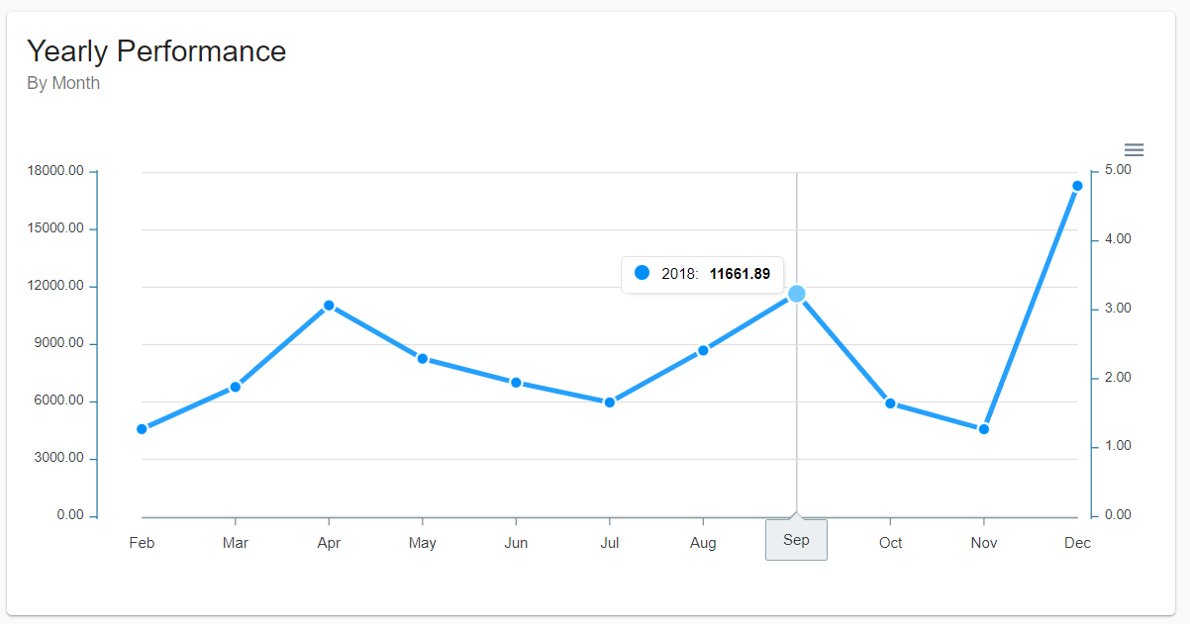
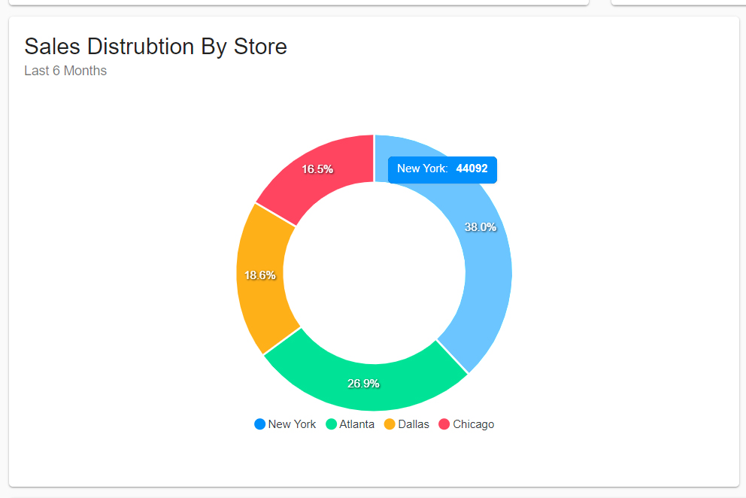
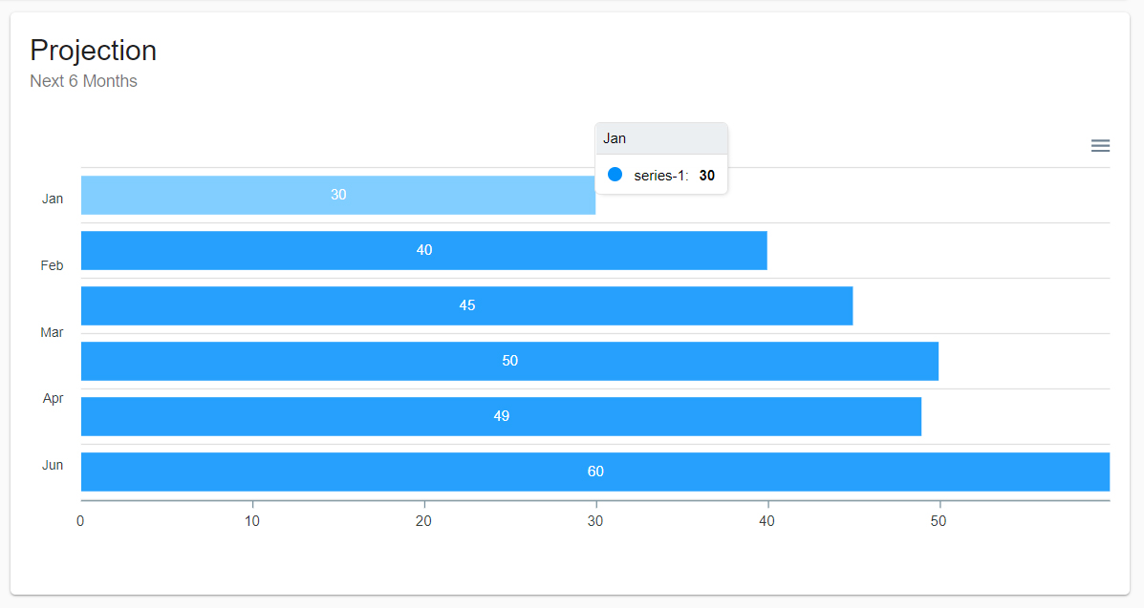
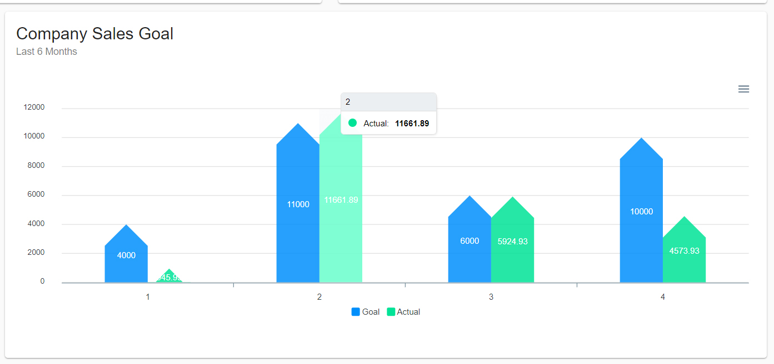
ApexCharts.js
Built-in support for React components

Slide 10
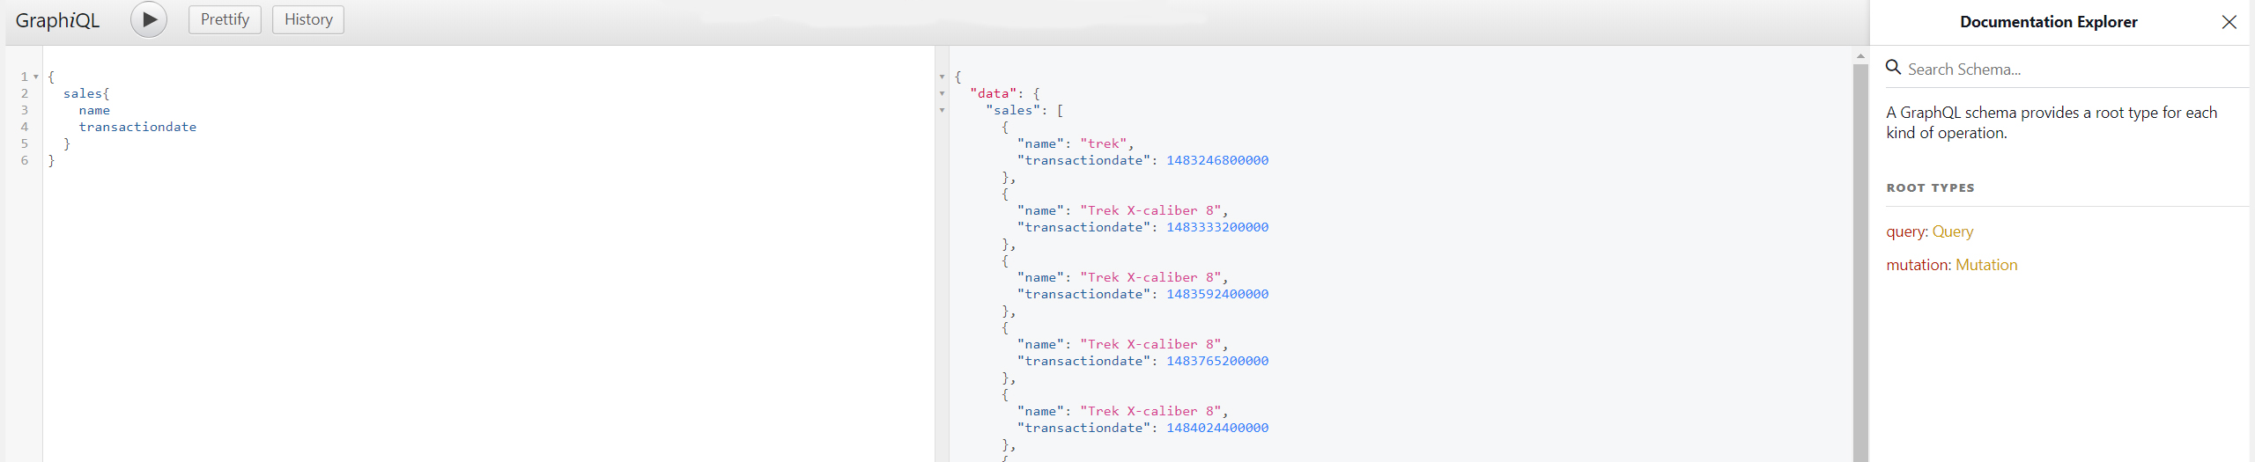
graphQL and graphiQL(GUI)
Manage data in MongoDB (CRUD)
Quickly retrieve data with one call to GraphQL instead of multiple calls from application
Use GraphiQL (GUI) to create/run queries and mutations manually (outside of code – dev only)
https://www.npmjs.com/package/graphql

Slide 11
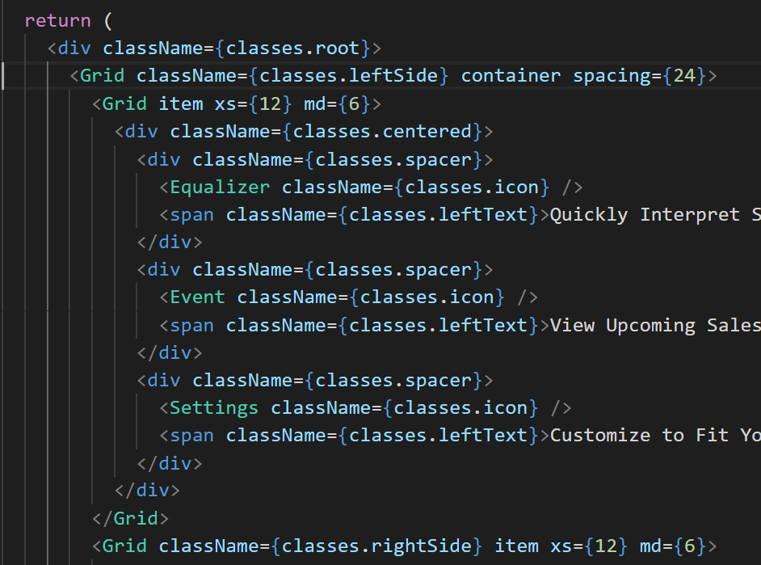
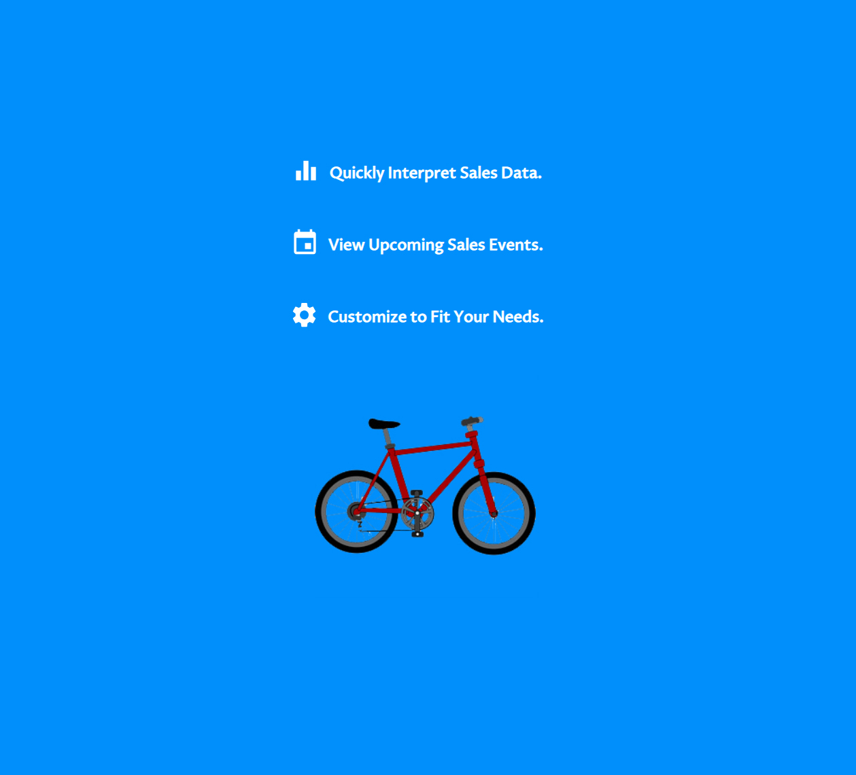
Material-UI
Built-in support for React components
https://material-ui.com/getting-started/installation/

Slide 12
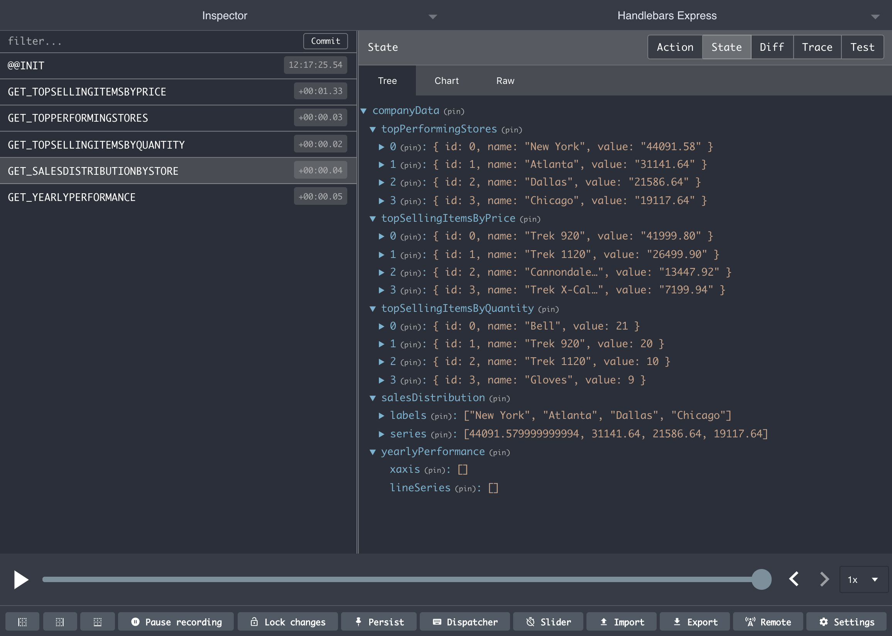
Redux
A module to make state management easier – provides one global state
Using Redux tool in Chrome, can view state for entire application
https://www.npmjs.com/package/redux
https://www.npmjs.com/package/redux-thunk

Slide 13

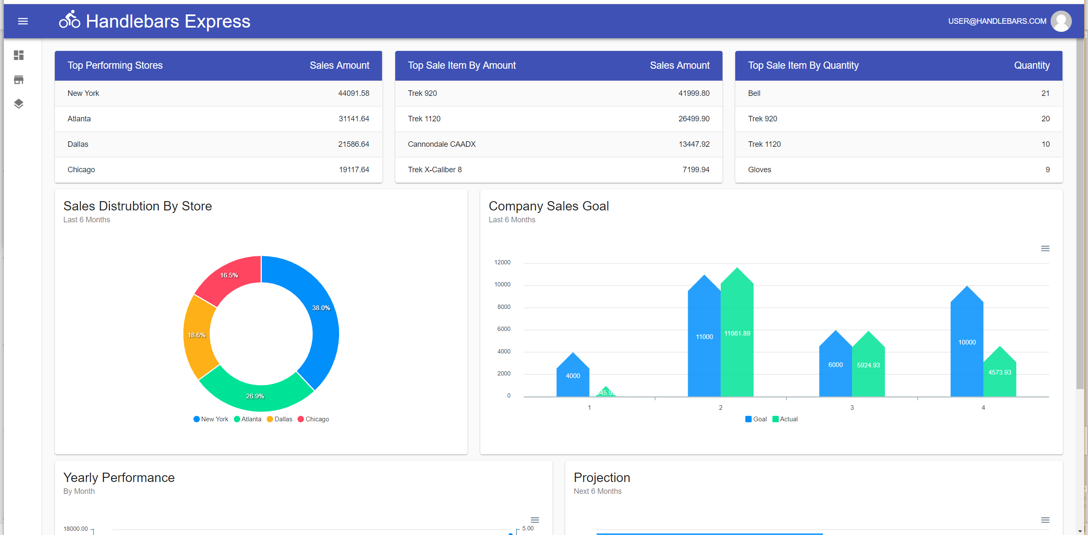
Peppermint Demo
Use case: Bicycle company – Handlebars Express

Slide 14
Future Development
Two-factor authentication to improve security
Support for custom views (Store, Item, etc.)
Support for custom widgets/charts
Support for real-time notifications

Slide 15
Thank You!
HELPFUL LINKS
GraphQL
Fullstack tutorial for GraphQL
https://www.howtographql.com/
How to pass query with variables to graphQL function
https://github.com/graphql/graphql-js/issues/1043
Four Simply Ways to call a GraphQL API
https://blog.apollographql.com/4-simple-ways-to-call-a-graphql-api-a6807bcdb355
REDUX
A Dummy’s Guide to Redux and Thunk in React
https://medium.com/@stowball/a-dummys-guide-to-redux-and-thunk-in-react-d8904a7005d3
CORS
Configuring CORS w/Dynamic Origin
https://www.npmjs.com/package/cors#configuring-cors-w-dynamic-origin
JWT Authentication
React Redux JWT Authentication Tutorial
http://jasonwatmore.com/post/2017/12/07/react-redux-jwt-authentication-tutorial-example
Authentication using JWT
https://deepstreamhub.com/tutorials/guides/jwt-auth/
Where to store tokens
https://auth0.com/docs/security/store-tokens
MongoDB
mongoDB Aggregation
https://docs.mongodb.com/manual/aggregation/
Questions?

